Slide 1
Printing with Thingworx
Sebastian Erler-Yates
Technical Sales Engineer
14.06.2019

Slide 2
Printing to PDF (using xsl and xml with apache fop)
Printing PDF on a real printer during runtime from thingworx
Printing data matrix codes (Barcodes, QR-codes, DotMatrix) with Zebra-Printers

Slide 3
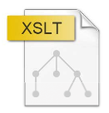
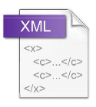

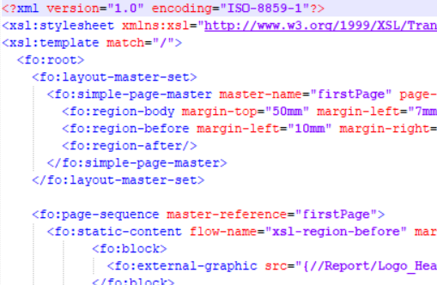
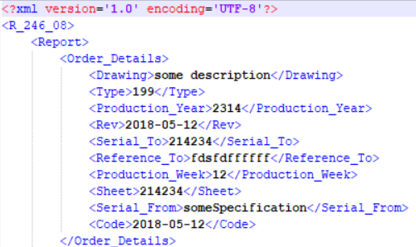
Printing to PDF – Alternative to PDF Extension
What you need
Software
Design
Data
The Apache™ FOP Project
Notes:
Apache™ FOP (Formatting Objects Processor) is a print formatter driven by XSL formatting objects (XSL-FO) and an output independent formatter. It is a Java application that reads a formatting object (FO) tree and renders the resulting pages to a specified output. Output formats currently supported include PDF, PS, PCL, AFP, XML (area tree representation), Print, AWT and PNG, and to a lesser extent, RTF and TXT. The primary output target is PDF.
"It requires you to:
•include a copy of the license in any redistribution you may make that includes Apache software;
•provide clear attribution to The Apache Software Foundation for any distributions that include Apache software."

Slide 4
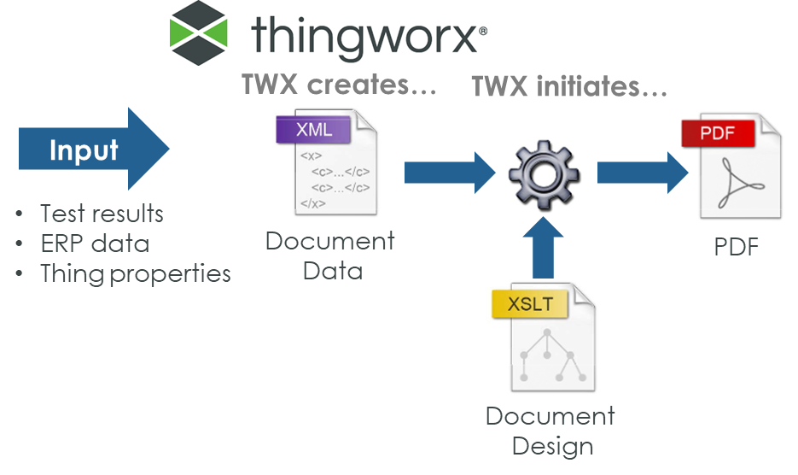
Printing to PDF – As a Flow

Slide 5
Demo

Slide 6
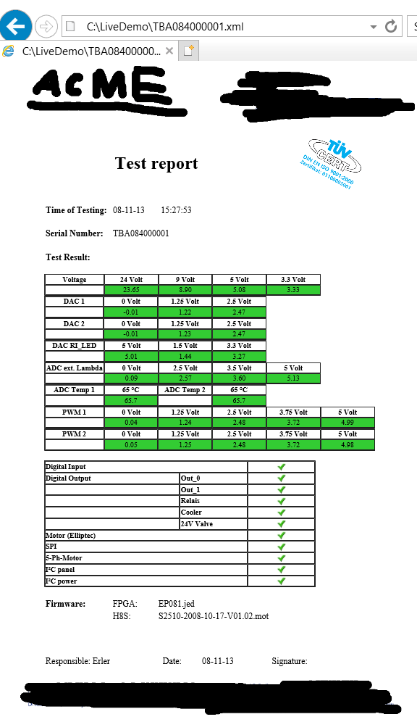
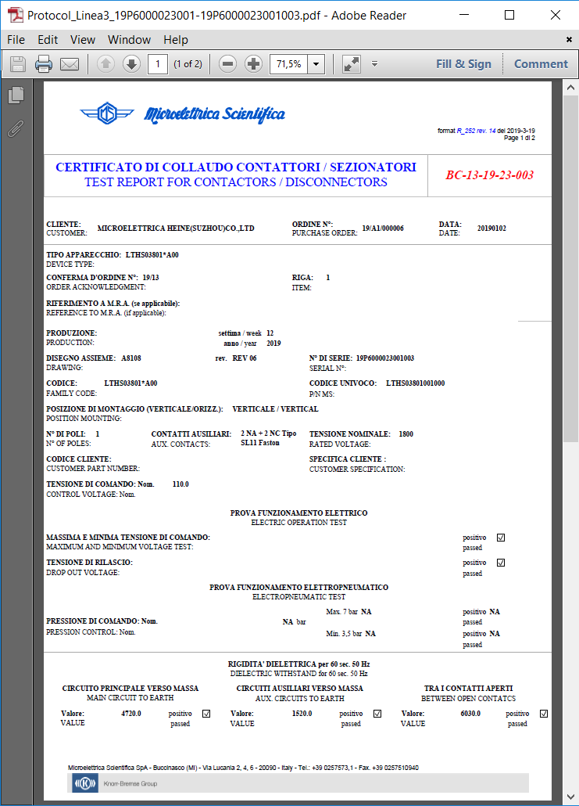

Slide 7





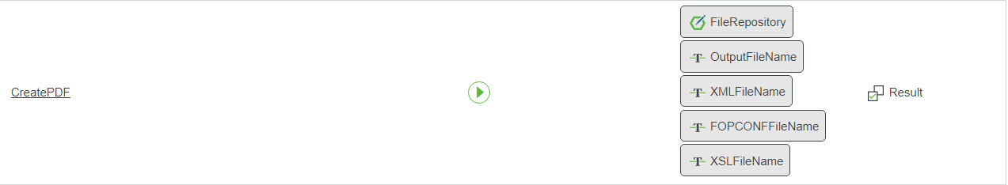
FOP Package for Thingworx
Extension:
(ExportJSONtoXML_extension.zip)
PDF_FOP_extension.zip
To FileRepository
protocolPDF_Linea3.xsl
fop.xconf

Slide 8
Printing PDF on a printer

Slide 9

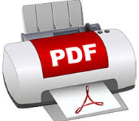
Printing PDF on a Printer
What you need
Software
Data
Windows (!!!)
Installed printer on TWX system
PDFtoPrinter: Command-line PDF printing
http://www.columbia.edu/~em36/pdftoprinter.html
Notes:
Windows program from a prof from university columbia
This system uses the free PDF-Xchange Viewer. You should consult the linked page to determine whether or not you may use that program for your own purposes. The compiled AutoIt script that wraps the PDF software is free for use by anyone, anywhere, for any purposes whatever.
The FREE PDF viewer download of the PDF-XChange Viewer may be used without limitation for Private, Commercial, Government and all uses, provided it is not -: incorporated or distributed for profit/commercial gain with other software or media distribution of any type - without first gaining permission.

Slide 10
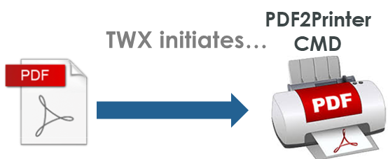
Printing PDF on a Printer – As a Flow

Slide 11
Demo

Slide 12
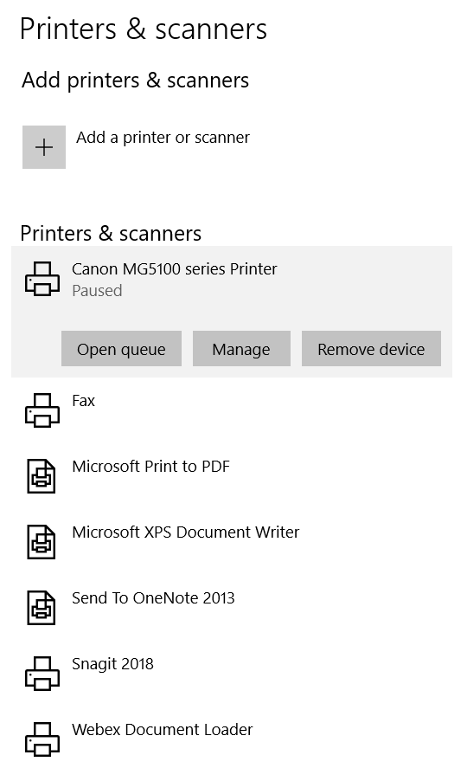
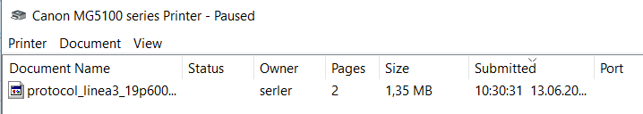
C:\LiveDemo>
PDFtoPrinter.exe Protocol_Linea3_19P6000023001-19P6000023001003.pdf "Canon MG5100 series Printer"

Slide 13

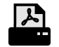

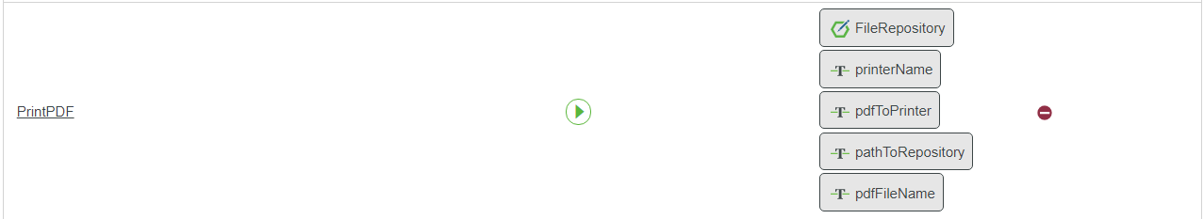
CMD Printing Package for Thingworx
Extension: PDFtoPrinter_extension.zip
To FileRepository
PDFtoPrinter.exe

Slide 14
Printing Data Matrix codes

Slide 15
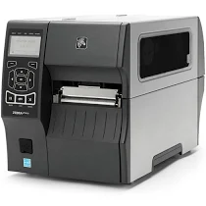
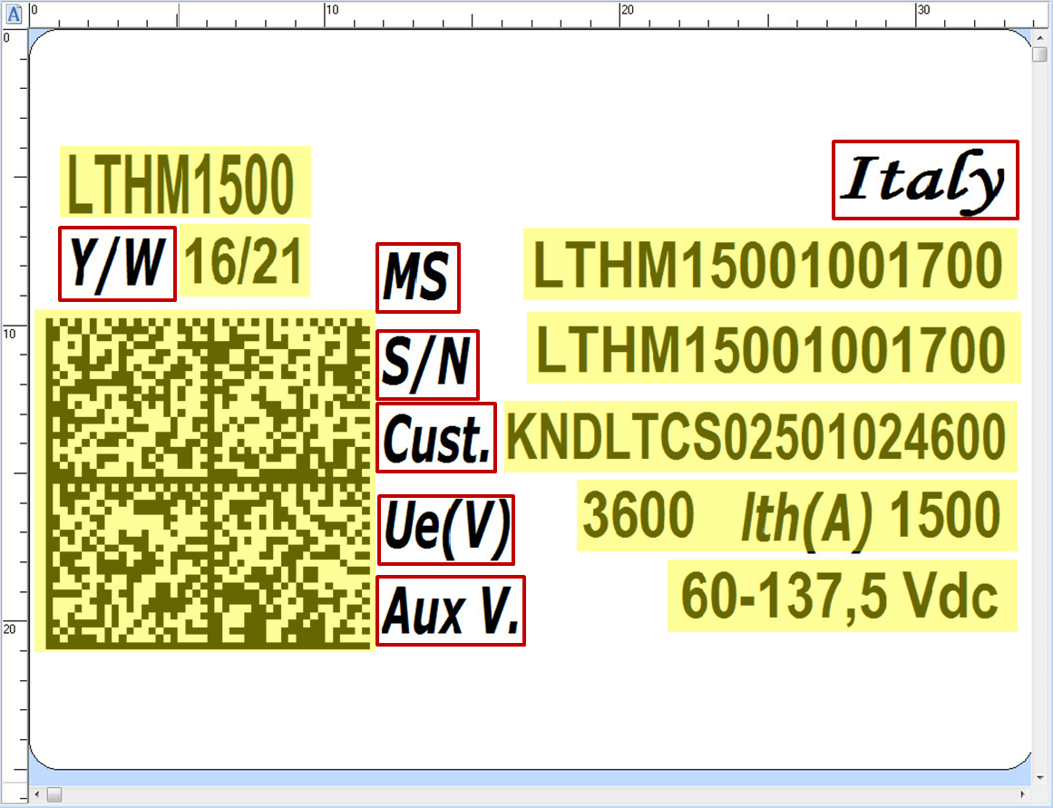
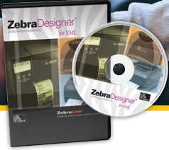
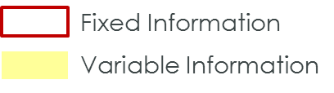
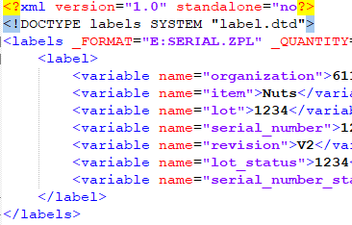
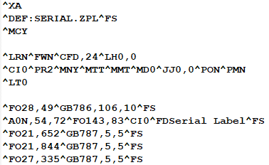
Printing Data Matrix Codes
What you need
Software
Design
Data
Hardware
ZebraDesigner for XML
Zebra Printer *
→ ZPL File
or understanding of zpl
* XML printing capabilities needed
Notes:
Apache™ FOP (Formatting Objects Processor) is a print formatter driven by XSL formatting objects (XSL-FO) and an output independent formatter. It is a Java application that reads a formatting object (FO) tree and renders the resulting pages to a specified output. Output formats currently supported include PDF, PS, PCL, AFP, XML (area tree representation), Print, AWT and PNG, and to a lesser extent, RTF and TXT. The primary output target is PDF.

Slide 16
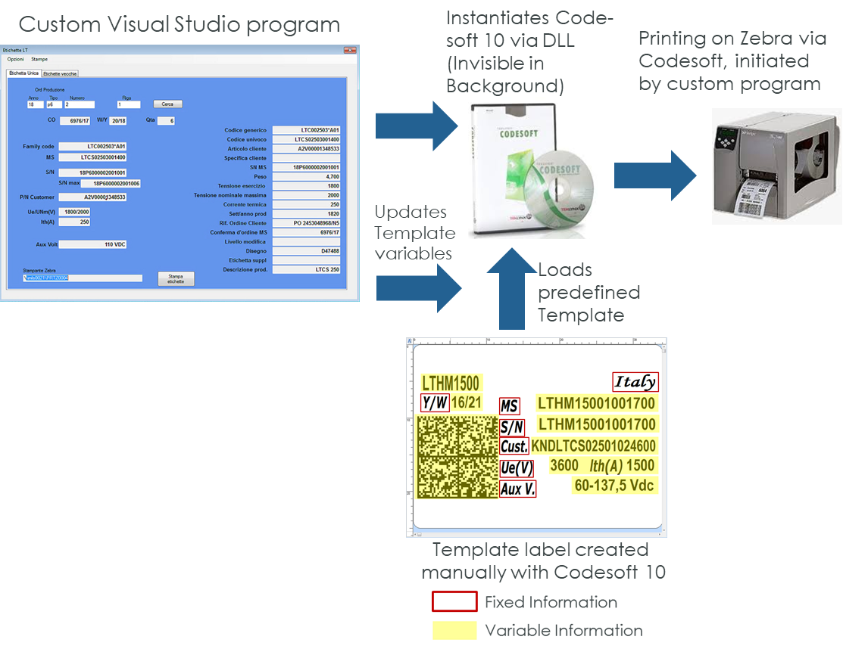
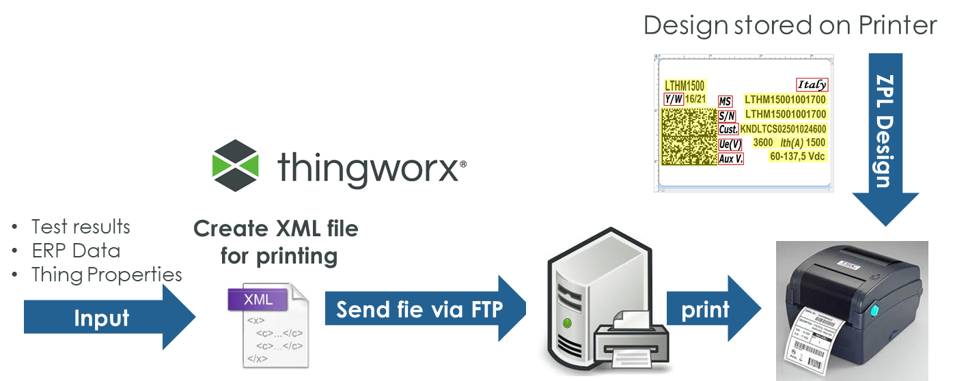
Printing Data Matrix Codes – As a Flow
Old process of printing Data Matrix
Printing Data Matrix with Thingworx

Slide 17
Demo

Slide 18
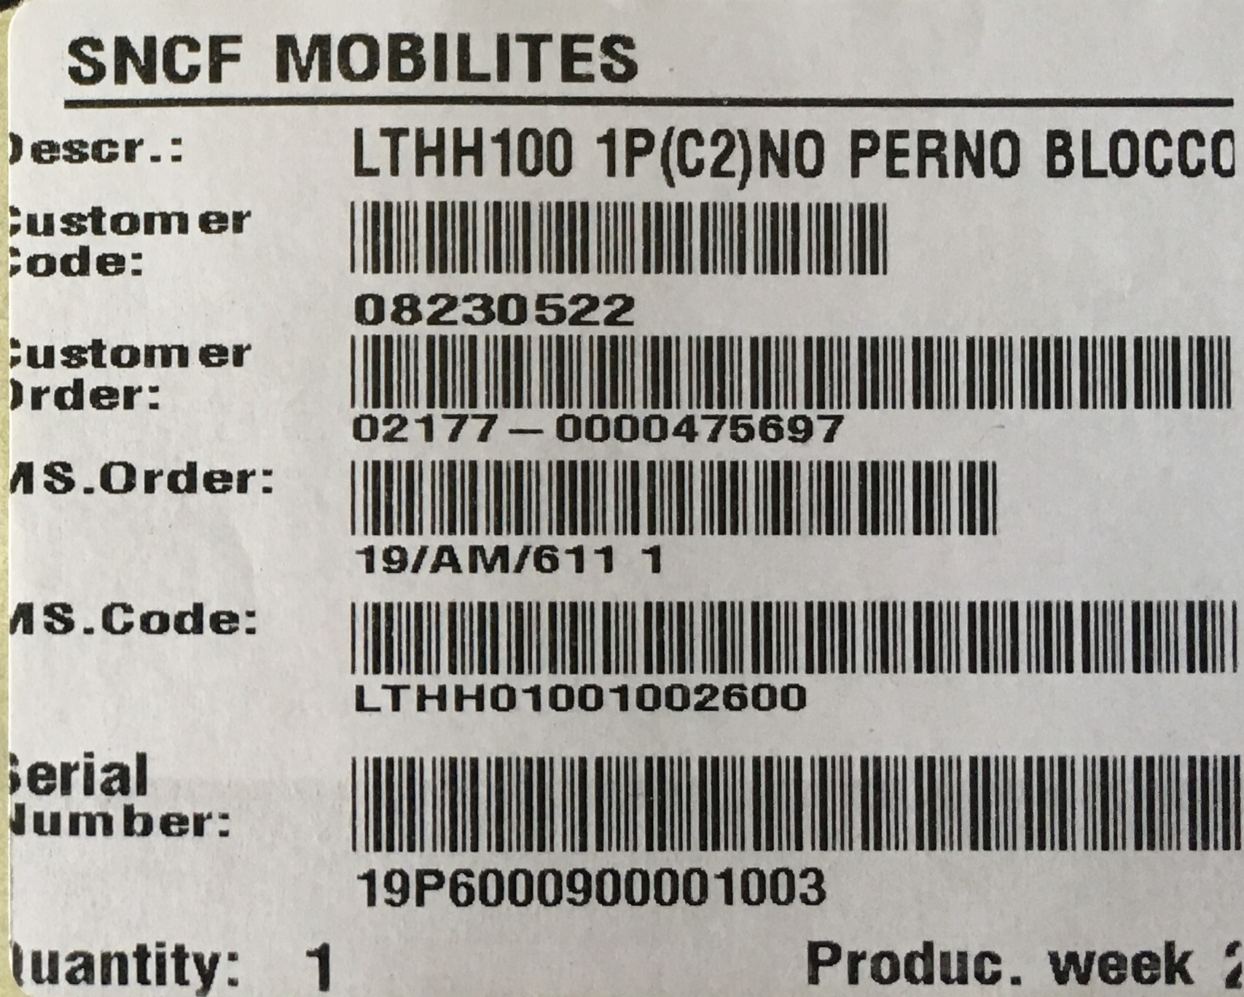
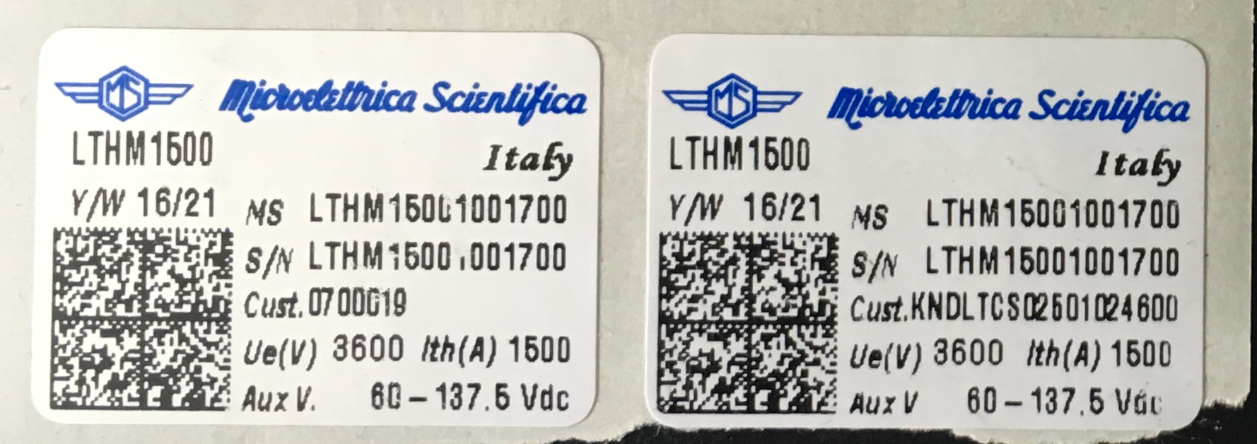
Results

Slide 19

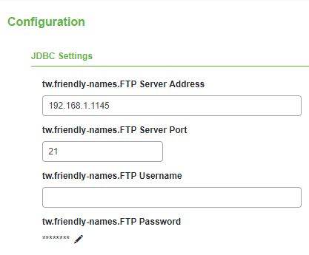

Zebra Printer as PDF Server

